Slide 1
CIS 624 Programming Languages
Dave Patterson, Walt O’Connor, Matt Hall

Slide 2
Parser
Sly parser generator to parse the input code
Returns an abstract syntax tree (AST)

Slide 3
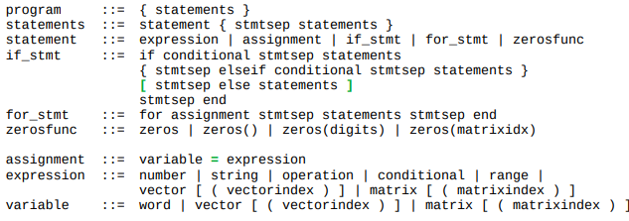
EBNF
for index = values statements end
EBNF describes construction of the parser
Initial EBNF had conflicts that were not translatable to our implementation

Slide 4
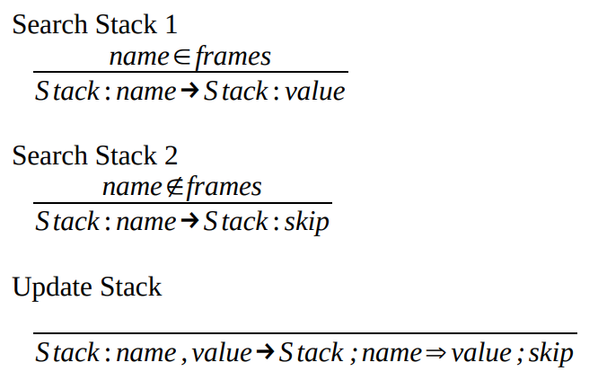
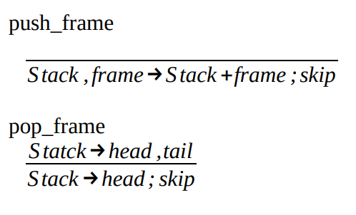
Operational Semantics
Modeled semantics scope with “stack of heaps (frames)”
Heaps are implemented as Python dictionaries
Stacks are Python lists

Slide 5
Interpreter
Evaluate left and right expression for side effects
Compute the value of the binary expression using the cached values from the left and right expressions
Store that result and return the stack with the side effects from the left and right trees applied

Slide 6
Binary Expression Evaluation
def __init__(self, left: Expr, op, right: Expr):
self.left = left\ self.right = right\ self.op = op
def eval(self, ctx):
ctx2 = self.left.eval(ctx)
ctx3 = self.right.eval(ctx2)
…
self.result = ops[self.op](self.left.get_value(), self.right.get_value())
return ctx3
def get_value(self):
return self.result

